Slide 1
Publishing
GROW Event
Thomas Gray
November 4, 2022

Slide 2
The Logistics of Publishing
Pick a journal

Slide 3
The Logistics of Publishing
How do you know which journal to submit to?
Read the journals.
What kinds of articles do they publish?
What do their articles look like?
What methods do they use?
What questions do they ask?
If you don’t know, ask.
But you will only learn fully yourself by reading the journals.

Slide 4
The Logistics of Publishing
Pick a journal
Verify the submission requirements
Submit (usually online)
An editor reviews whether it is a possible publication
If so, it is “sent out” to 2-4 peer reviewers
Most, but not all, are “double blind”
The standards for acceptance differ by journal
Outcomes: Reject or Revise-and-Resubmit
You receive the reviews in either case

Slide 5
The Logistics of Publishing
Revise-and-Resubmit
Revise your work in line with the reviews
Prepare a Revision Memo with your revised manuscript, outlining the changes you made, and responses to the reviews.
Resubmit
Potential outcomes: another R&R, conditional acceptance, rejection
If conditional acceptance, you will make a limited set of revisions that the editor will verify.
Finally, acceptance.
Proofs, contracts, data uploading, etc. etc.
Article in print

Slide 6
A few notes
This takes a long time.

Slide 7
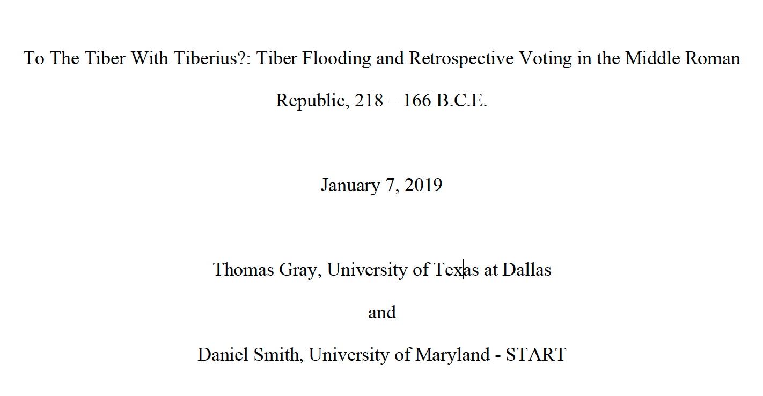
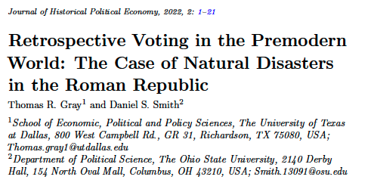

Slide 8
A few notes
This takes a long time and a lot can change along the way.
Rejection is common.
You should be getting rejections, because you should be submitting papers.

Slide 9
A few notes
This takes a long time and a lot can change along the way.
Rejection is common.
You should be getting rejections, because you should be submitting papers.
Remember that this is a process of people – even if you never see them.
Be polite
Be flexible
Be timely

