Slide 1
Grant Opportunities for PhD Students
11/04/2022
Yongwan Chun

Slide 2
Grants
“A grant is a way the government funds your ideas and projects to provide public services and stimulate the economy” - grants.gov
“A grant is a fund given by an end entity grant to an individual or another entity for a specific purpose linked to public benefit” - Wikipedia
This Photo by Unknown Author is licensed under CC BY-ND

Slide 3
Research grants
Grants support research
Can cover expenses for research activities
Tuitions, stipends, travels, materials, and more
Types
Government departments
Federal, State, Local
College-sponsored
Scientific societies
Corporate-sponsored
e.g., Google PhD Fellowship Program (https://research.google/outreach/phd-fellowship/)

Slide 4
Federal funding agencies
National Science Foundation (NSF)
National Institute of Health (NIH)
National Aeronautics and Space Administration (NASA)
US Department of Energy
US Department of Defense
US Department of Justice
US Department of Homeland Security
More
https://www.grants.gov/learn-grants/grant-making-agencies.html

Slide 5
Competitions
Heavy competitions
Hard to compete against people with an established career
Common for people in their early career stage
e.g., junior faculty members
Research grants only for students

Slide 6
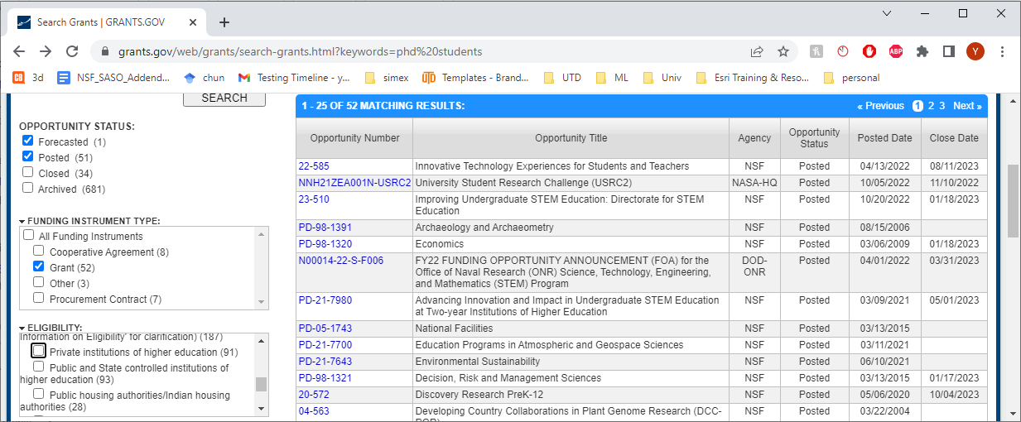
Where to search
Grants.gov, for example
Federal grants

Slide 7
Some places with a list
Organizations have compiled lists
AAAS
https://www.science.org/content/page/where-search-funding?cookieSet=1
UTD
https://research.utdallas.edu/researchers/grant-process/research-development/graduate-research-fellowships
Scientific Society
American Association of Geographers
https://www.aag.org/award-index/?view=aag-awards
North American Regional Science Council
https://www.narsc.org/newsite/awards-prizes/stevens-graduate-fellowship/

Slide 8
Some notable programs
NIH
Research Fellowship Awards (F)
F30: Individual Fellowship (MD/PhD students)
F31: Predoctoral Individual National Research Service Award
F32: Postdoctoral Individual National Research Service Award
NSF
Graduate Research Fellowship Program (GRFP)
Students who have completed no more than one academic year
https://www.nsfgrfp.org/
Doctoral Dissertation Research Improvement (DDRI) Awards

Slide 9
Alternatives to the GRFP
Department of Energy Computational Science Graduate Fellowship (link)
Department of Defense Science, Mathematics and Research for Transformation (SMART) Scholarship for Service (link)
Graduate Education for Minorities (GEM) Consortium Fellowships (link)
Graduate Fellowships for Science, Technology, Engineering, and Mathematics Diversity (link)
National Defense Science and Engineering Graduate Fellowship Program (NDSEG, link)

Slide 10
DDRI Awards
For doctoral students To improve the quality of their dissertation research
Funds cover a wide range of costs
Travel, data collection activities, equipment, subject payments, materials, and supplies
Potential programs
Human-Environment and Geographical Sciences (HEGS-DDRI)
The American Sociological Association (ASA DDRIG)
The Sociology DDRIG program has transferred from NSF to ASA
Economics (link)
Decision, Risk and Management Science (link)
Science and Technology Studies (link)
They have different deadlines

Slide 11
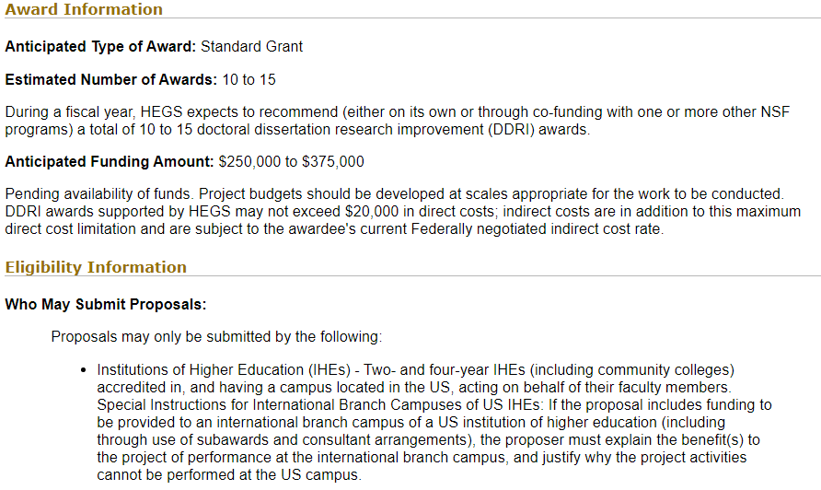
HEGS-DDRI

Slide 12
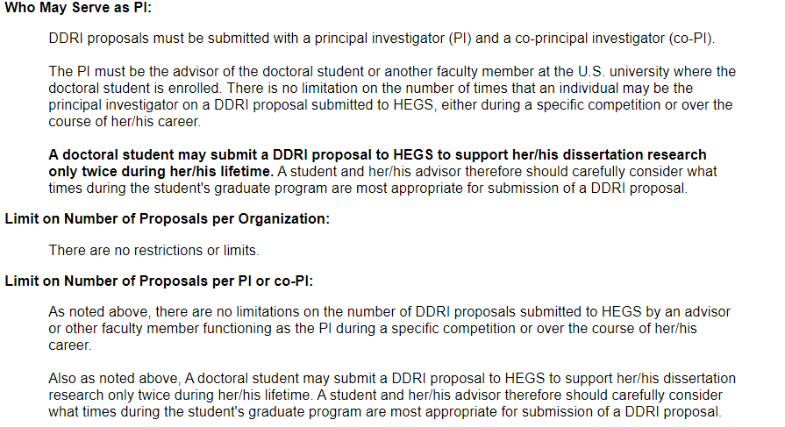
HEGS-DDRI

Slide 13
How to write a good proposal
Beyond the scope of this presentation
Resources are available
UTD: Proposal writing resource
https://research.utdallas.edu/researchers/grant-process/research-development/proposal-writing-resources
NSF workshops
e.g., DDRI Workshop 2021 https://www.researchdevelopment.socsci.uci.edu/files/documents/2021/NSF%20DDRI%20Workshop-F2021.pdf
Your advisor can be your primary resources

Slide 14
Questions

