Slide 1
Grant and dissertation funding
The Office of Graduate Education
May 2023

Slide 2
Agenda
Grants vs. Fellowships vs. Scholarships
What you need to think about before you search
Who you are (and therefore who might fund you?)
Timing
Where and how to search

Slide 3
Grants vs. fellowships vs. scholarships
Grants
Research grants
Fellowships
Scholarships
Training grants

Slide 4
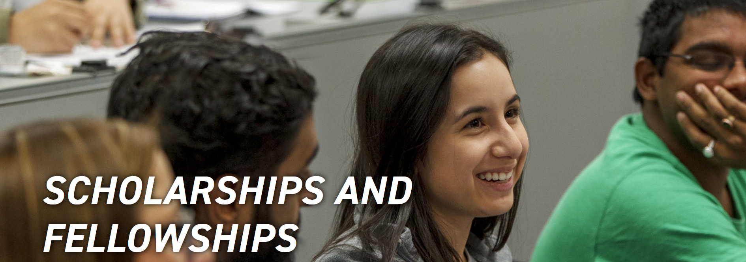
Internal versus External
Internal
External
EPPS opportunities epps.utdallas.edu/future-students/scholarships/
OGE opportunities graduate.utdallas.edu/research/dissertation_research_awards
For any student with money provided by a non-UTD organization such as:
American Political Science Association (APSA)
American Society of Criminology (ASC)
Association for Public Policy Analysis and Management (APPAM)
Economic History Association (EHA)
National Institute of Justice (NIJ)

Slide 5
What to know about
Funding for your dissertation
Three types of award
Usually, research focused
Funding for your masters
Timing can work against you
Tend to be more demographic than research

Slide 6
How to find the opportunities
Draft the paragraph
I am working towards a (insert degree) in (insert program) so that I can (insert long term career/life goal). If I achieve my goals, I will be able to (insert impact).
List who you are
Related to your field
Related to your identity (gender, race, religion)

Slide 7
For example
I am working towards an MA in History so I can become a historian in a museum. If I achieve my goals, I will teach the general public about the importance of history in current events (‘Those who cannot remember the past are condemned to repeat it’
I am:
A woman
Born in Philadelphia
A graduate from The University of Missouri
A trained journalist
A non-traditional student (older)
A parent
About You
Area of Study

Slide 8
Timing

Slide 9
How to find them
Any type
Pivot (https://pivot.proquest.com)
Only fellowships
Fellowship Finder (https://apps.grad.illinois.edu/fellowship-finder/)
Before you give up, Google
“master’s support for”
“organizations for”
“resources for”

Slide 10
Final thoughts/Pieces of Advice
Apply for both internal and external funding
You can’t be awarded for what you didn’t apply for
You can apply to multiple programs at the same time – you may only be able to accept one though
You will need letters of recommendation for fellowships and jobs - if you are not making yourself known, now would be a good time to start
I am here to help at any stage of the application process but am more useful the sooner you engage me

Slide 11
Thanks for listening! If I can help, email me at keithly@utdallas.edu Schedule a meeting at calendly.com/keithly

